Slide 1
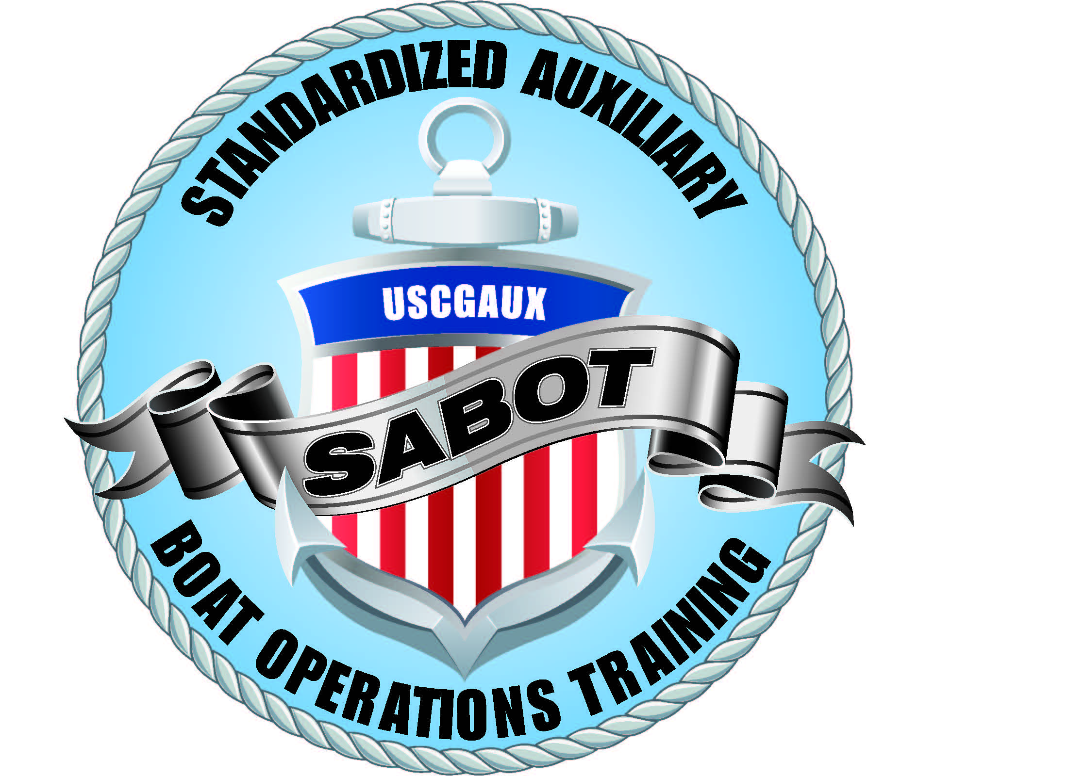
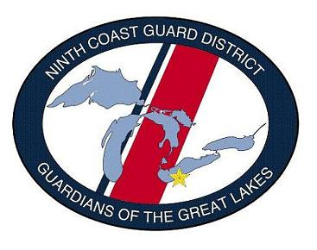
NINTH DISTRICT EASTERN REGION
NIGHT SURFACE OPERATIONS
Como. Lew Wargo, Sr.
CQEC 9ER
01 Apr 2015
Night Surface OPR

Slide 2
Welcome
Why do we need night ops training?
“I’ve driven boats all my life”

Slide 3
Welcome
Why do we need night ops training?
“I’ve driven boats all my life” (Night conditions are different)

Slide 4
Welcome
Why do we need night ops training?
“I’ve driven boats all my life” (Night conditions are different)
“I operate at night all the time”

Slide 5
Welcome
Why do we need night ops training?
“I’ve driven boats all my life” (Night conditions are different)
“I operate at night all the time” (Has your crew)

Slide 6
Welcome
Why do we need night ops training?
“I’ve driven boats all my life” (Night conditions are different)
“I operate at night all the time” (Has your crew)
_ “I’ve never had an accident”

Slide 7
Welcome
Why do we need night ops training?
“I’ve driven boats all my life” (Night conditions are different)
“I operate at night all the time” (Has your crew)
_ “I’ve never had an accident”(There’s always a first time)

Slide 8
Night Operations
“Night Operations”, for the purposes of this presentation, is defined as any surface mission aboard an AUXFAC that occurs between dusk and dawn, or in conditions of limited visibility requiring the use of navigation lights (fog, rain, less than ¼ mile visibility and/or other factors).
See Inland and International Rule # 19 (Navigation Rules) for details.

Slide 9
Fatal Accident
December 20, 2009, 1744 hours (Dark)San Diego Holiday Boat Parade
CG 33118 moving at 42 kts (NTSB report)
responding to a non-distress sailboat aground
CG 33118 struck an anchored boat
An 8 year old boy was killed

Slide 10
Night Operations
While we train in the light, the SAR call may come at night.
Some ATON patrols must be done at night
BCM-08-02-AUX requires a night underway navigation and piloting exercise
NOTE: Not waived in 9ER

Slide 11
NIGHT OPERATIONS
Fireworks and many Holiday boat parades are conducted after dark.
Many SAR cases happen after dark.
Hard to distinguish Navigation Lights from holiday lights and background shore lighting

Slide 12
NIGHT OPERATIONS
Fireworks Safety Patrols are very dangerous
Things (some hot things) are falling from the sky Everyone is looking up, not out

Slide 13
General Rules
Conduct a thorough mission briefing:
Discuss specific mission goals
Discuss how reduced visibility will affect navigation & avoiding hazards that may be encountered.

Slide 14
General Rules
Adapt to night vision and conserve it
No white lights
Extra caution moving on weather decks Keep one eye closed if white light must be used

Slide 15
General Rules
Change interior lights to red or blue
Use caution reading charts in red light - Magenta marks disappear

Slide 16
General Rules
Slow down, Remember NAV RULE 6
“Every vessel shall at all times proceed at a safe speed so that she can take proper and effective action to avoid a collision and be stopped within a distance appropriate to the prevailing circumstances and conditions”.

Slide 17
General Rules
To determine that safe speed, the Nav Rules list factors:
Visibility, traffic density, maneuverability of the vessel (stop, turn distances), background light & “scatter” that may impact vision, draft & water depth, sea state & weather.

Slide 18
Night Operations
If ever in doubt of the vessels’ position
STOP!

Slide 19
Night Operations
Regain your situational awareness by:
Bringing the vessel to a full stop.
Deploying the anchor if necessary.
Do not continue patrol until your exact position and circumstances have been determined.

Slide 20
Night Operations
How current are your electronic charts?
How current are your paper charts?
Electronic charts are known to have errors.
Trust…but verify.

Slide 21
Night Operations
Use your hearing, Stop and Listen
Maintain a proper watch
Use extra lookouts.

Slide 22
Night Operations
Consider attaching Chem-Lights to tow lines so you can actually see the line and stand a proper tow watch.
Light the tow line with a spot light
Have crew stand bye with a portable spot light to warn other vessels of tow

Slide 23
Night Operations
Alertness levels may drop off at night.
More frequent helm and lookout changes may be required to maintain an alert crew.
The most difficult period to maintain alertness and awareness is between 2100-0700 hours.

Slide 24
Night Vision
You should have 20/20 (or corrected to 20/20) to see obstacles, navigation lights and aids to navigation.
It takes healthy people up to 60 minutes in darkness to adapt to night vision.
People have problems with glare as they age.

Slide 25
Night Vision
Individuals who smoke and/or drink have decreased visual acuity.
Alcohol has the following effects
Blurred or double vision
Slow pupil reaction
Decreased peripheral vision
Altered contrast sensitivity

Slide 26
Night Operations Equipment
The OIA will decide what limitations will be placed on night & limited visibility operations & what equip is necessary.
CG policy requires RADAR if visibility is under 1 mile at any time of day!

Slide 27
Night Operations Equipment
GPS-RADAR
As a general rule, any facility that might operate at night or in conditions of limited visibility should be equipped with GPS and RADAR, and the operator must be able to competently use that equipment safely.

Slide 28
Night Operations Equipment
NAVRULE 7 states;
“Proper use shall be made of radar equipment if fitted and operational”.
If you have it you must use it (all hours, not just at night) and be competent in it’s use.
Make sure your watch standers know how to read the screen.

Slide 29
Night Operations Equipment
Tow Lights
The tow light configuration described in Rule 24
of the Navigation Rules regarding night towing
operations is a good idea but is not required for
AUXFACS.

Slide 30
Night Operations Equipment
Where from any sufficient cause it is impracticable for a vessel not normally engaged in towing operations to display the lights prescribed in paragraph (a) or (c) of this Rule, such vessel shall not be required to exhibit those lights when engaged in towing another vessel in distress or otherwise in need of assistance. All possible measures shall be taken to indicate the nature of the relationship between the towing vessel and the vessel being towed as authorized by Rule 36, in particular by illuminating the towline.

Slide 31
Night Operations
The Coxswain should assign one crew member to constantly monitor the Radar screen in addition to the helmsman. This crew person must be competent with Radar, keep a watchful eye on the screen and communicate conditions clearly with the Coxswain and helmsman.

Slide 32
Night Operations
Speeds should be limited for conditions

Slide 33
Summary
The 7 elements of TCT are especially important during night operations.
LEADERSHIP
COMMUNICATIONS
ASSERTIVENESS
ADAPTABILITY AND FLEXIBILITY
SITUATIONAL AWARENESS
DECISION MAKING
MISSION ANALYSIS

Slide 34
Summary
Be guided by and communicate with your OIA and appointed officers when night operations are planned.

Slide 35
References
COMDTPUB 16754.27, 2013. Recreational Boating Statistics.
Code of Federal Regulations. 46 CFR 10.305(a), Vision Requirements, Deck Standard.
Bedinhaus, T. DO, June 3, 2014. USAF Special Report, AL-SR-1992-0002, Night Vision Manual for the Flight Surgeon, written by Robert E. Miller II, Col, USAF, (RET) and Thomas J. Tredici, Col, USAF, (RET).
USCG, November 18, 2014. Navigation Rules and Regulations Handbook.
COMDTINST 16772.2D, July 1, 2013. Navigation Rules: International-Inland (superseded).
National Transportation Safety Board, July 12, 2011. Collision Between U.S. Coast Guard Vessel CG 33118 and Sea Ray Recreational Vessel CF 2607 PZ, San Diego Bay, California, December 20,2009
Night Surface Operations Guide, National Response Dept..

